Slide 1

NSG Pilkington – University of Liverpool Machine Learning Project: 23/06/2021
Dr. Peter Green
Diego Echeverria
Sarini Jayasinghe
Risk Institute,
School of Engineering

Slide 2
Today
Content:
GP with Automatic Relevance Determination
Predictions with uncertain tag data
ISRA 5D
Upskilling:
Linear regression
How do we learn ‘online’?
What actually is a Neural Network?
What is a Gaussian Process?
How does PCA work?
Shannon Entropy

Slide 3
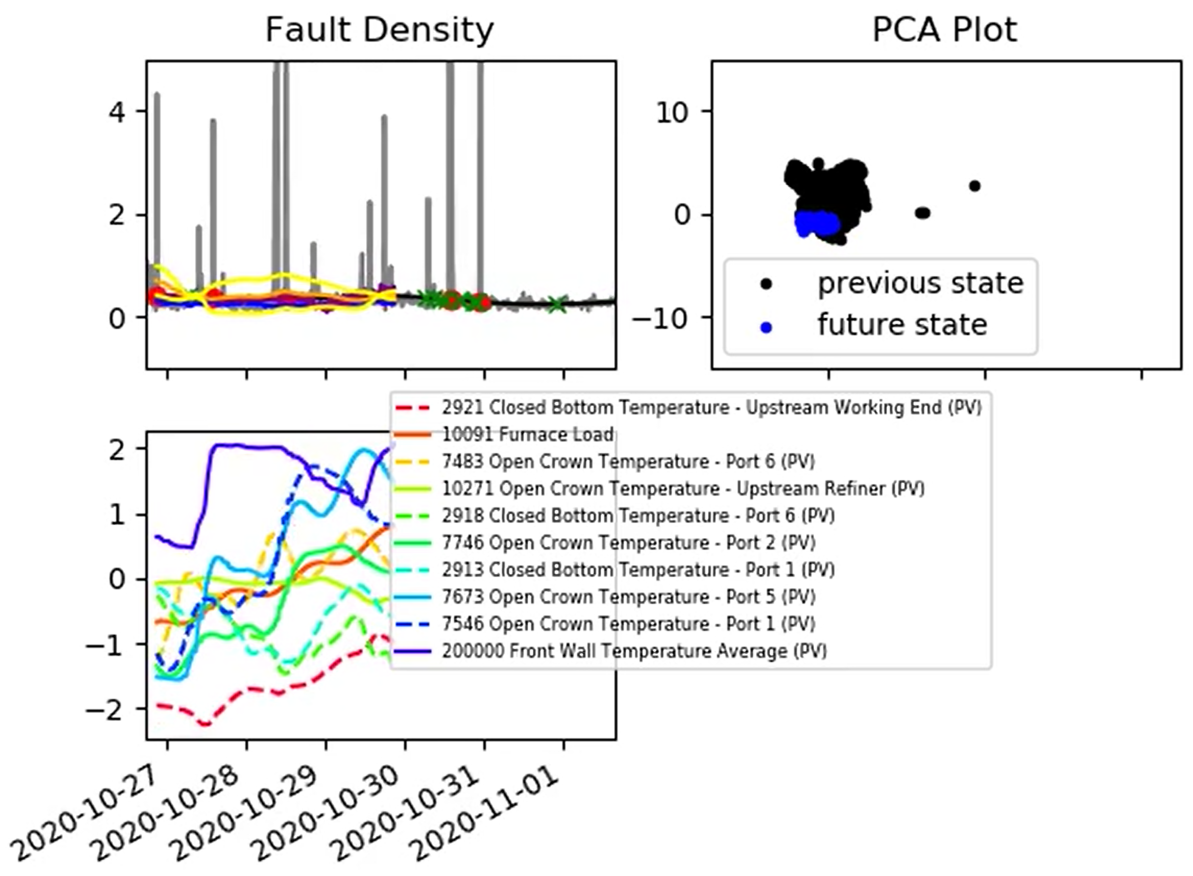
GP with Automatic Relevance Determination
2021-06-21_results.mp4 to be uploaded to the sharepoint later today

Slide 4
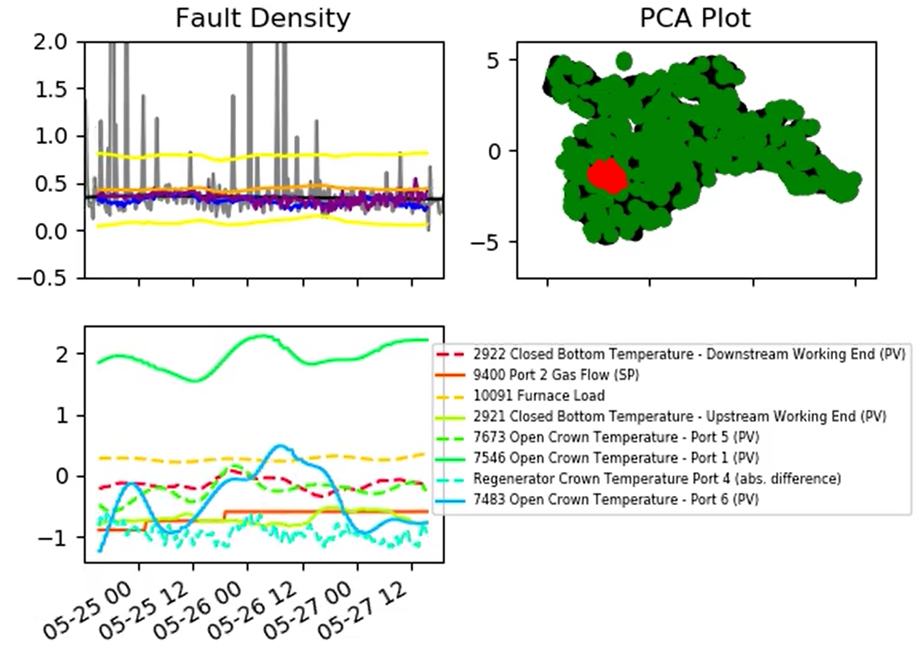
GP with Automatic Relevance Determination
2021-06-21_test_results.mp4 to be uploaded to the sharepoint later today

Slide 5
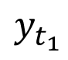
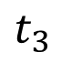
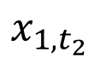
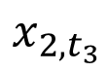
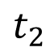
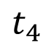
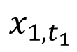
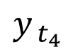
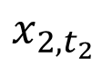
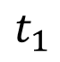
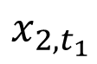
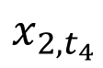
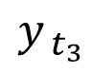
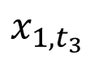
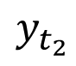
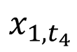
Predictions with Uncertain Tag Data
Observed
Hidden
$$y_{t_{1}}$$
$$y_{t_{2}}$$
$$y_{ t_{3}}$$
$$y_{ t_{4}}$$
$$x_{1, t_{1}}$$
$$x_{1, t_{2}}$$
$$x_{1, t_{3}}$$
$$x_{1, t_{4}}$$
$$x_{2, t_{1}}$$
$$x_{2, t_{2}}$$
$$x_{2, t_{3}}$$
$$x_{2, t_{4}}$$
$$t_{1}$$
$$t_{2}$$
$$t_{3}$$
$$t_{4}$$
This is our current model – all inputs are fully observed.

Slide 6
Predictions with Uncertain Tag Data
Observed
Hidden
$$y_{t_{1}}$$
$$y_{t_{2}}$$
$$y_{ t_{3}}$$
$$y_{ t_{4}}$$
$$x_{1, t_{1}}$$
$$x_{1, t_{2}}$$
$$x_{1, t_{3}}$$
$$x_{1, t_{4}}$$
$$x_{2, t_{1}}$$
$$x_{2, t_{2}}$$
$$x_{2, t_{3}}$$
$$x_{2, t_{4}}$$
$$t_{1}$$
$$t_{2}$$
$$t_{3}$$
$$t_{4}$$
In reality, due to time lags, some of the inputs become ‘hidden’. How do we treat these uncertain inputs?

Slide 7
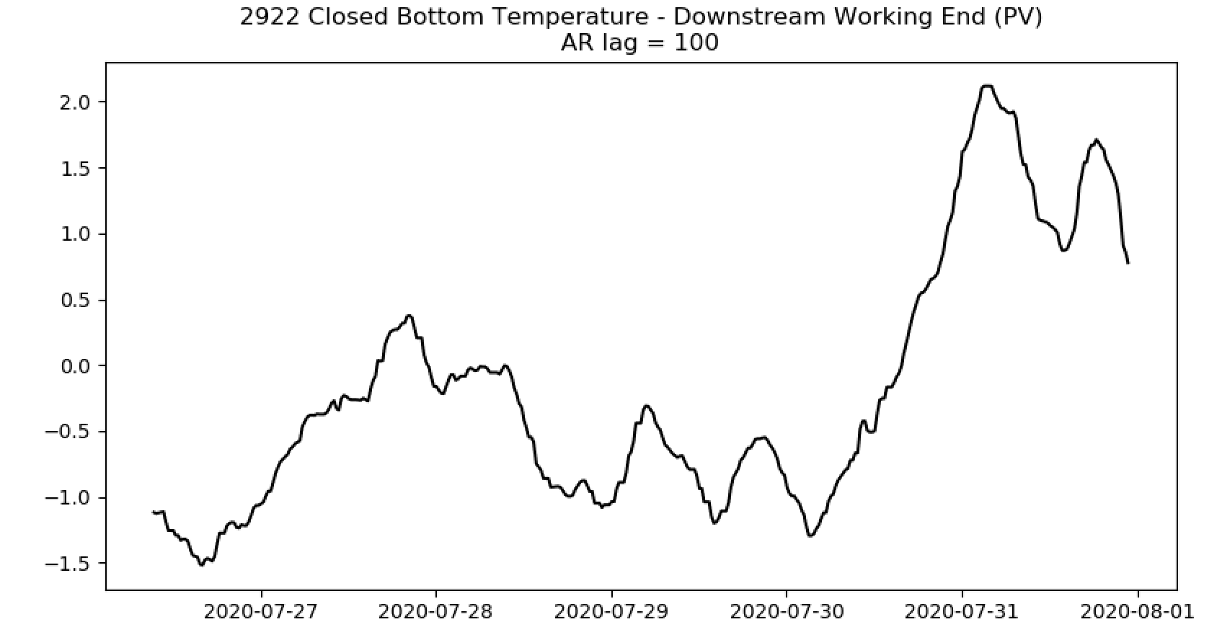
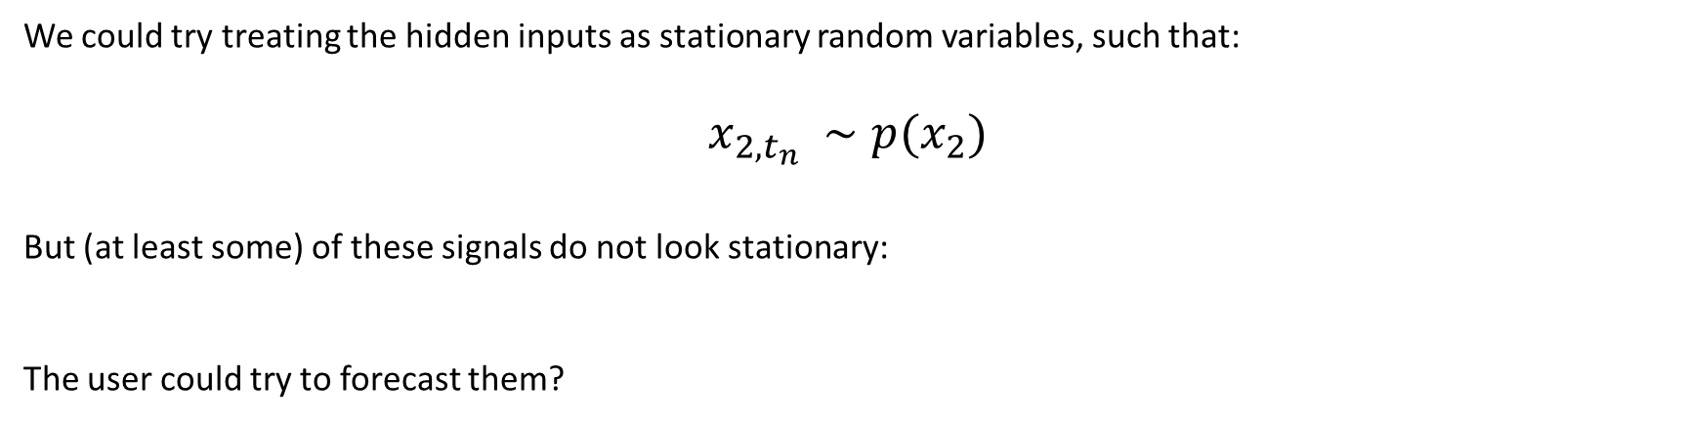
Predictions with Uncertain Tag Data
We could try treating the hidden inputs as stationary random variables, such that:
$x_{2, t_{n} }∼p(x_{2})$
But (at least some) of these signals do not look stationary:
The user could try to forecast them?

Slide 8
Predictions with Uncertain Tag Data
Observed
Hidden
$$y_{t_{1}}$$
$$y_{t_{2}}$$
$$y_{ t_{3}}$$
$$y_{ t_{4}}$$
$$x_{1, t_{1}}$$
$$x_{1, t_{2}}$$
$$x_{1, t_{3}}$$
$$x_{1, t_{4}}$$
$$x_{2, t_{1}}$$
$$x_{2, t_{2}}$$
$$x_{2, t_{3}}$$
$$x_{2, t_{4}}$$
$$t_{1}$$
$$t_{2}$$
$$t_{3}$$
$$t_{4}$$

Slide 9
Predictions with Uncertain Tag Data
Observed
Hidden
$$y_{t_{1}}$$
$$y_{t_{2}}$$
$$y_{ t_{3}}$$
$$y_{ t_{4}}$$
$$x_{1, t_{1}}$$
$$x_{1, t_{2}}$$
$$x_{1, t_{3}}$$
$$x_{1, t_{4}}$$
$$x_{2, t_{1}}$$
$$x_{2, t_{2}}$$
$$x_{2, t_{3}}$$
$$x_{2, t_{4}}$$
$$t_{1}$$
$$t_{2}$$
$$t_{3}$$
$$t_{4}$$
It is unlikely that the hidden signals are correlated to inputs that are still known.

Slide 10
Predictions with Uncertain Tag Data
Observed
Hidden
$$y_{t_{1}}$$
$$y_{t_{2}}$$
$$y_{ t_{3}}$$
$$y_{ t_{4}}$$
$$x_{1, t_{1}}$$
$$x_{1, t_{2}}$$
$$x_{1, t_{3}}$$
$$x_{1, t_{4}}$$
$$x_{2, t_{1}}$$
$$x_{2, t_{2}}$$
$$x_{2, t_{3}}$$
$$x_{2, t_{4}}$$
$$t_{1}$$
$$t_{2}$$
$$t_{3}$$
$$t_{4}$$
Time series are traditionally treated using an Autoregressive approach (here with one lag term).

Slide 11
Predictions with Uncertain Tag Data
Observed
Hidden
$$y_{t_{1}}$$
$$y_{t_{2}}$$
$$y_{ t_{3}}$$
$$y_{ t_{4}}$$
$$x_{1, t_{1}}$$
$$x_{1, t_{2}}$$
$$x_{1, t_{3}}$$
$$x_{1, t_{4}}$$
$$x_{2, t_{1}}$$
$$x_{2, t_{2}}$$
$$x_{2, t_{3}}$$
$$x_{2, t_{4}}$$
$$t_{1}$$
$$t_{2}$$
$$t_{3}$$
$$t_{4}$$
Time series are traditionally treated using an Autoregressive approach (here with two lag terms).

Slide 12
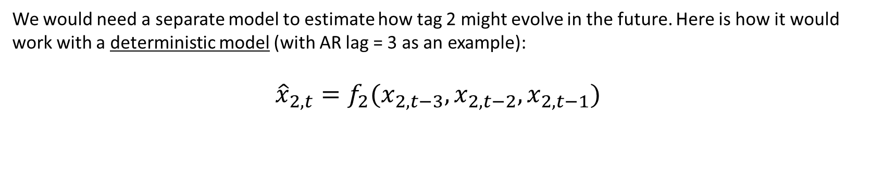
Predictions with Uncertain Tag Data
We would need a separate model to estimate how tag 2 might evolve in the future. Here is how it would work with a deterministic model (with AR lag = 3 as an example):
$${\hat{x}}_{2,t}=f_{2}(x_{2,t−3},x_{2,t−2},x_{2,t−1})$$

Slide 13
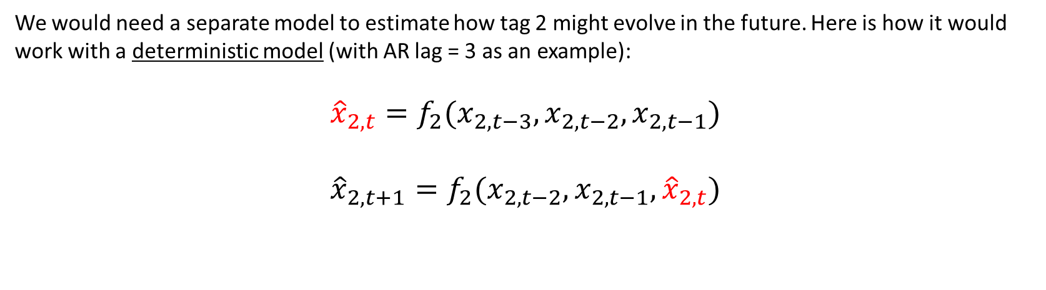
Predictions with Uncertain Tag Data
We would need a separate model to estimate how tag 2 might evolve in the future. Here is how it would work with a deterministic model (with AR lag = 3 as an example):
$${\hat{x}}_{2,t}=f_{2}(x_{2,t−3},x_{2,t−2},x_{2,t−1})$$
$${\hat{x}}_{2,t+1}=f_{2}(x_{2,t−2},x_{2,t−1},{\hat{x}}_{2,t})$$

Slide 14
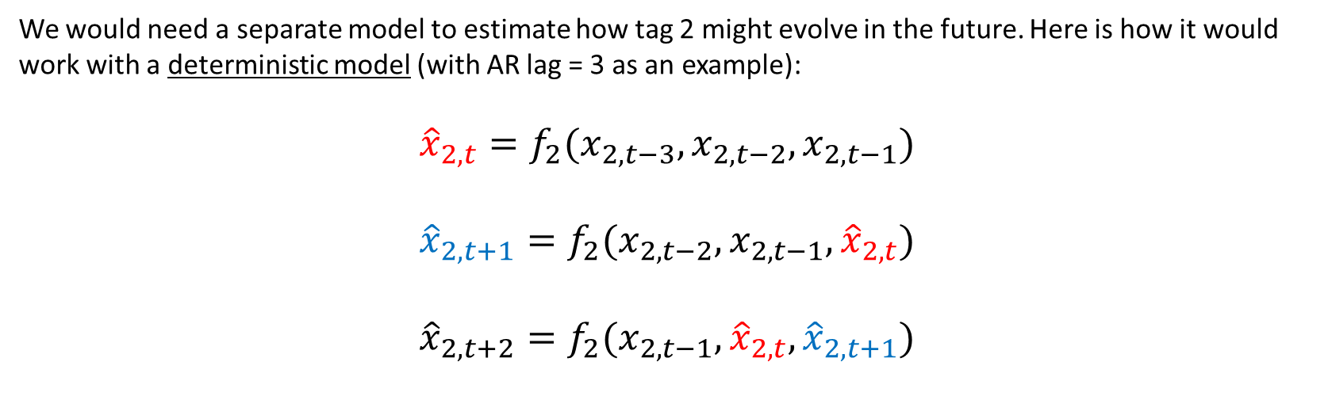
Predictions with Uncertain Tag Data
We would need a separate model to estimate how tag 2 might evolve in the future. Here is how it would work with a deterministic model (with AR lag = 3 as an example):
$${\hat{x}}_{2,t}=f_{2}(x_{2,t−3},x_{2,t−2},x_{2,t−1})$$
$${\hat{x}}_{2,t+1}=f_{2}(x_{2,t−2},x_{2,t−1},{\hat{x}}_{2,t})$$
$${\hat{x}}_{2,t+2}=f_{2}(x_{2,t−1},{\hat{x}}_{2,t},{\hat{x}}_{2,t+1})$$

Slide 15
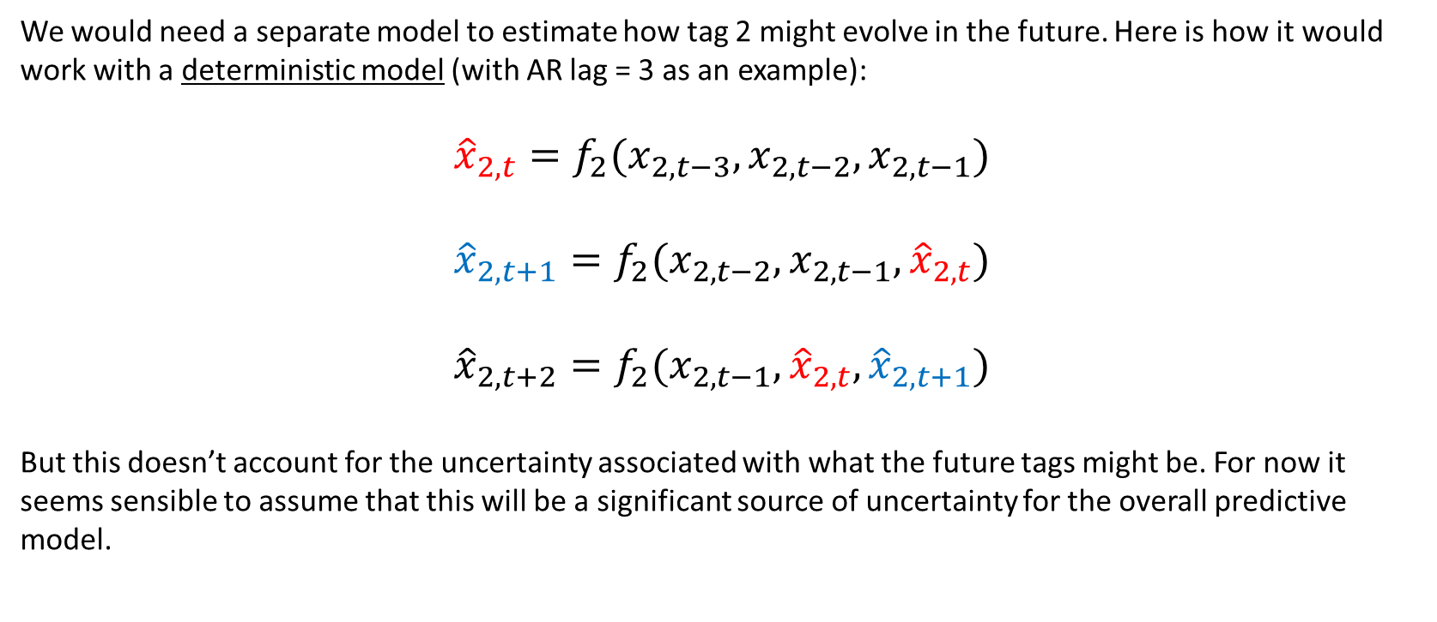
Predictions with Uncertain Tag Data
We would need a separate model to estimate how tag 2 might evolve in the future. Here is how it would work with a deterministic model (with AR lag = 3 as an example):
$${\hat{x}}_{2,t}=f_{2}(x_{2,t−3},x_{2,t−2},x_{2,t−1})$$
$${\hat{x}}_{2,t+1}=f_{2}(x_{2,t−2},x_{2,t−1},{\hat{x}}_{2,t})$$
$${\hat{x}}_{2,t+2}=f_{2}(x_{2,t−1},{\hat{x}}_{2,t},{\hat{x}}_{2,t+1})$$
But this doesn’t account for the uncertainty associated with what the future tags might be. For now it seems sensible to assume that this will be a significant source of uncertainty for the overall predictive model.

Slide 16
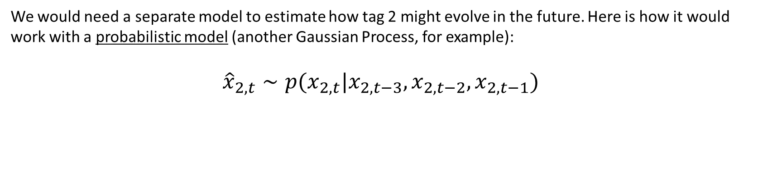
Predictions with Uncertain Tag Data
We would need a separate model to estimate how tag 2 might evolve in the future. Here is how it would work with a probabilistic model (another Gaussian Process, for example):
$${\hat{x}}_{2,t}∼p(x_{2,t}|x_{2,t−3},x_{2,t−2},x_{2,t−1})$$

Slide 17
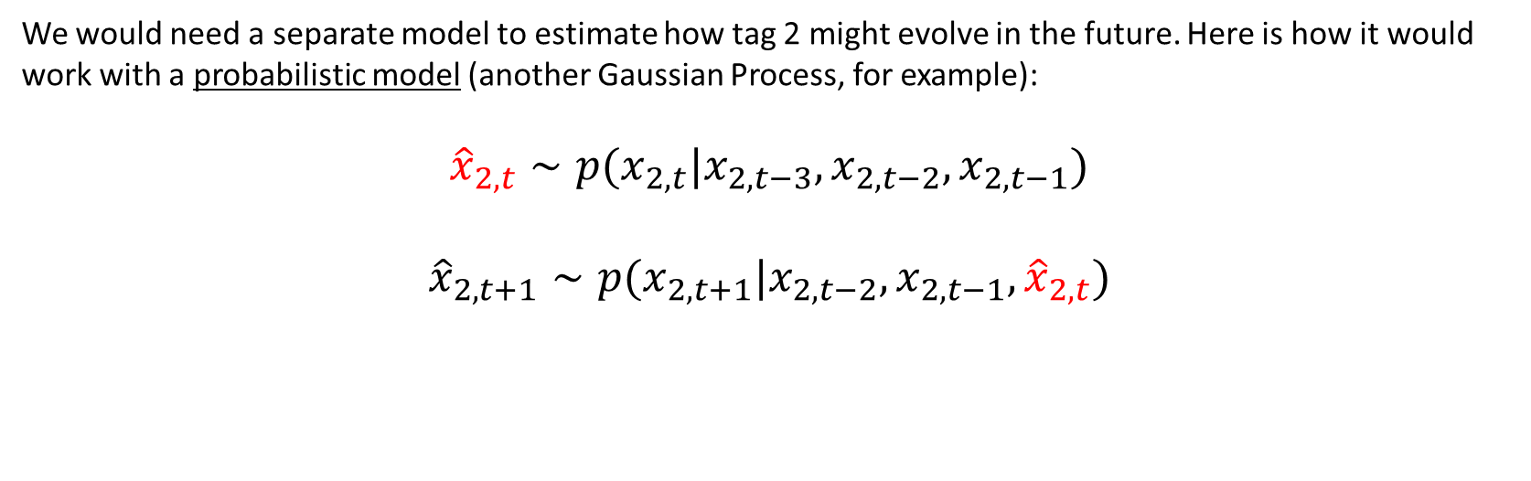
Predictions with Uncertain Tag Data
We would need a separate model to estimate how tag 2 might evolve in the future. Here is how it would work with a probabilistic model (another Gaussian Process, for example):
$${\hat{x}}_{2,t}∼p(x_{2,t}|x_{2,t−3},x_{2,t−2},x_{2,t−1})$$
$${\hat{x}}_{2,t+1}∼p(x_{2,t+1}|x_{2,t−2},x_{2,t−1},{\hat{x}}_{2,t})$$

Slide 18
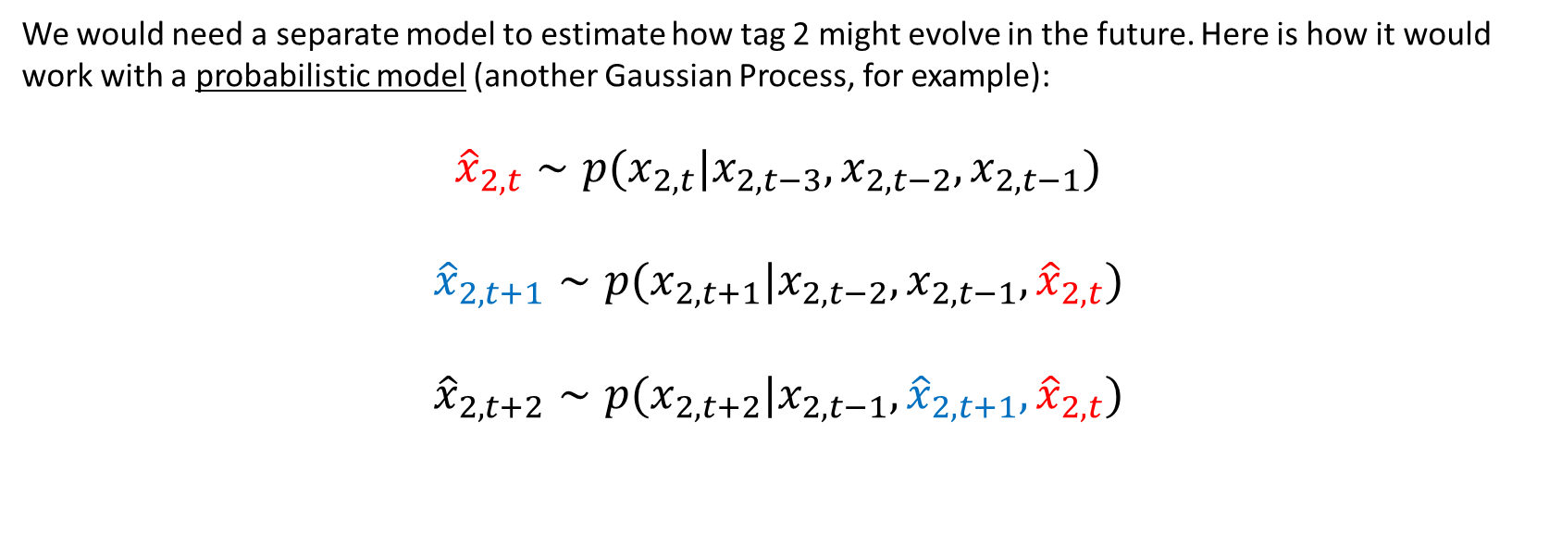
Predictions with Uncertain Tag Data
We would need a separate model to estimate how tag 2 might evolve in the future. Here is how it would work with a probabilistic model (another Gaussian Process, for example):
$${\hat{x}}_{2,t}∼p(x_{2,t}|x_{2,t−3},x_{2,t−2},x_{2,t−1})$$
$${\hat{x}}_{2,t+1}∼p(x_{2,t+1}|x_{2,t−2},x_{2,t−1},{\hat{x}}_{2,t})$$
$${\hat{x}}_{2,t+2}∼p(x_{2,t+2}|x_{2,t−1},{\hat{x}}_{2,t+1},{\hat{x}}_{2,t})$$

Slide 19
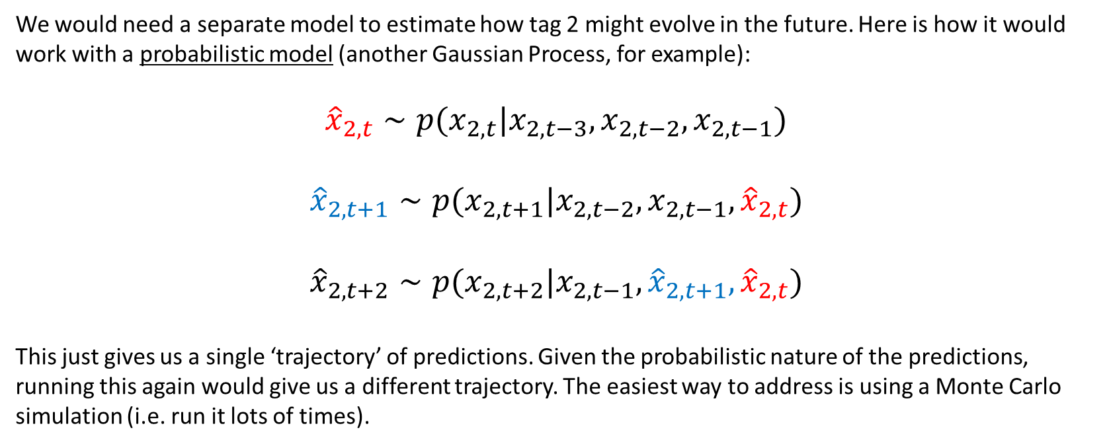
Predictions with Uncertain Tag Data
We would need a separate model to estimate how tag 2 might evolve in the future. Here is how it would work with a probabilistic model (another Gaussian Process, for example):
$${\hat{x}}_{2,t}∼p(x_{2,t}|x_{2,t−3},x_{2,t−2},x_{2,t−1})$$
$${\hat{x}}_{2,t+1}∼p(x_{2,t+1}|x_{2,t−2},x_{2,t−1},{\hat{x}}_{2,t})$$
$${\hat{x}}_{2,t+2}∼p(x_{2,t+2}|x_{2,t−1},{\hat{x}}_{2,t+1},{\hat{x}}_{2,t})$$
This just gives us a single ‘trajectory’ of predictions. Given the probabilistic nature of the predictions, running this again would give us a different trajectory. The easiest way to address is using a Monte Carlo simulation (i.e. run it lots of times).

Slide 20
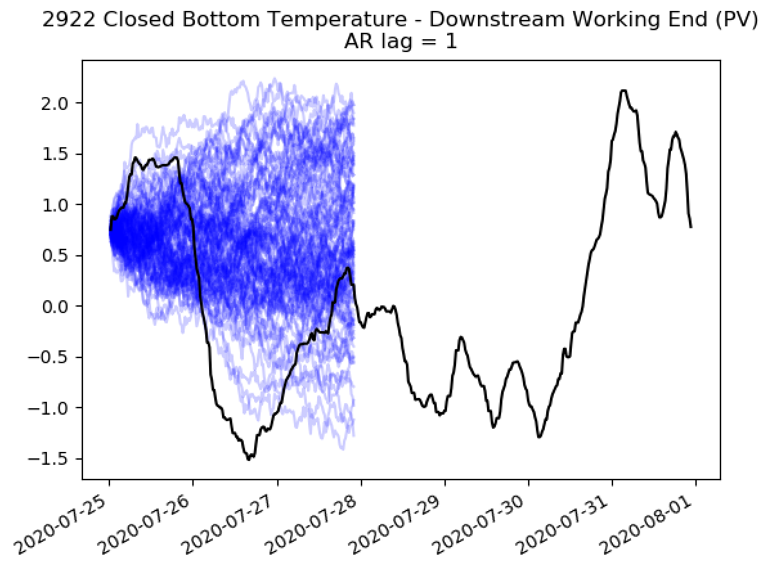
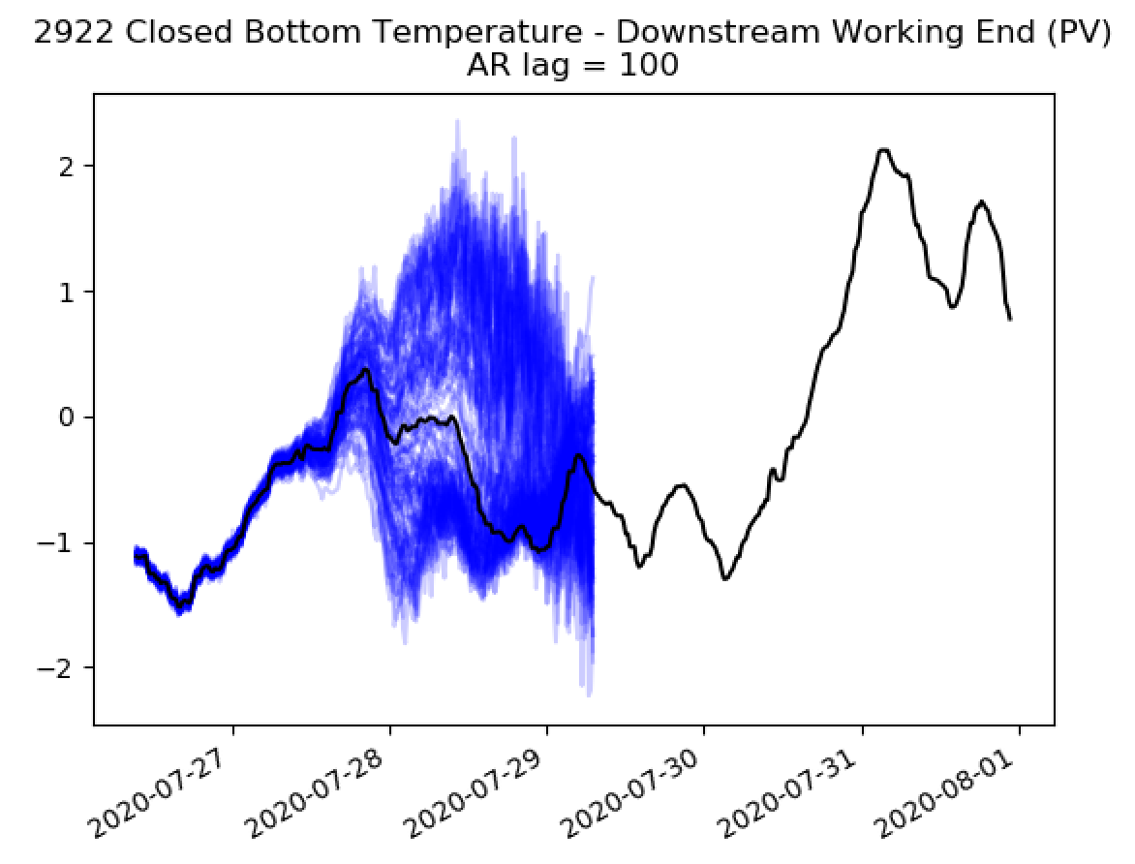
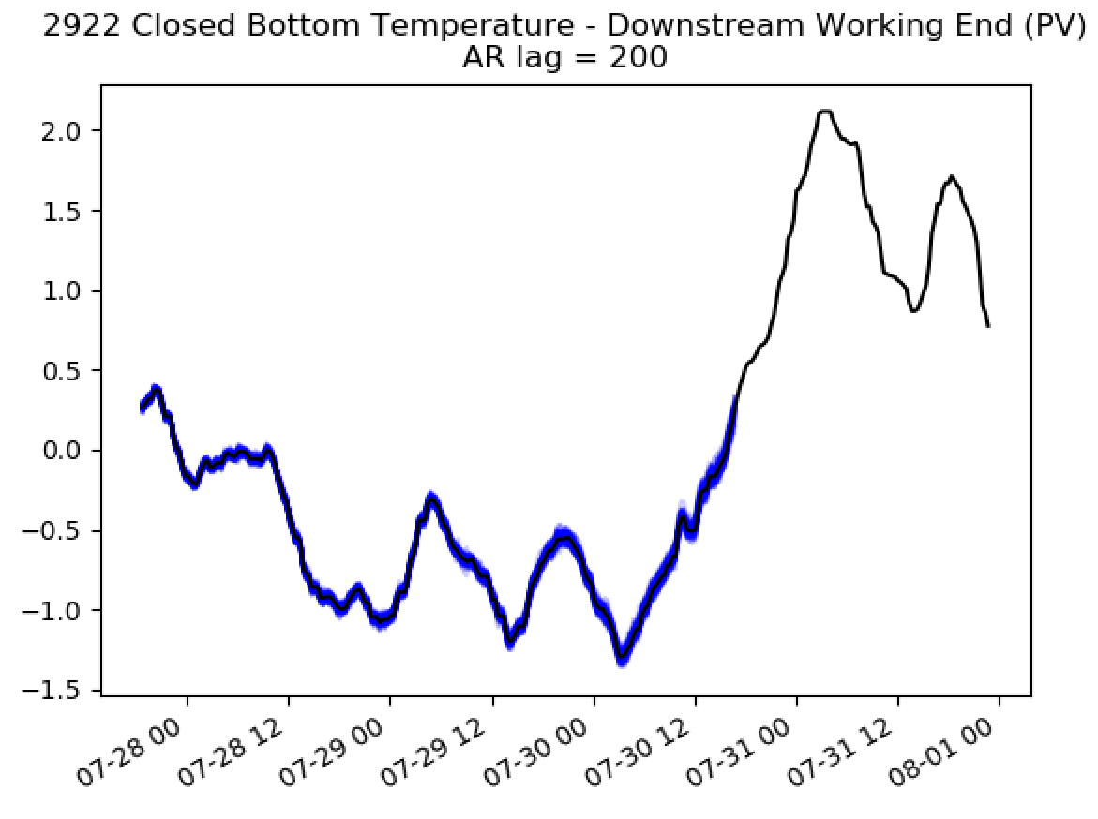
Predictions with Uncertain Tag Data
Here the time lag is equal to 2 hours, so we have to predict this input 70 hours into the future.
Note that the AR model was trained on this data! Results may be very different when we come to interpolate between training points.

Slide 21
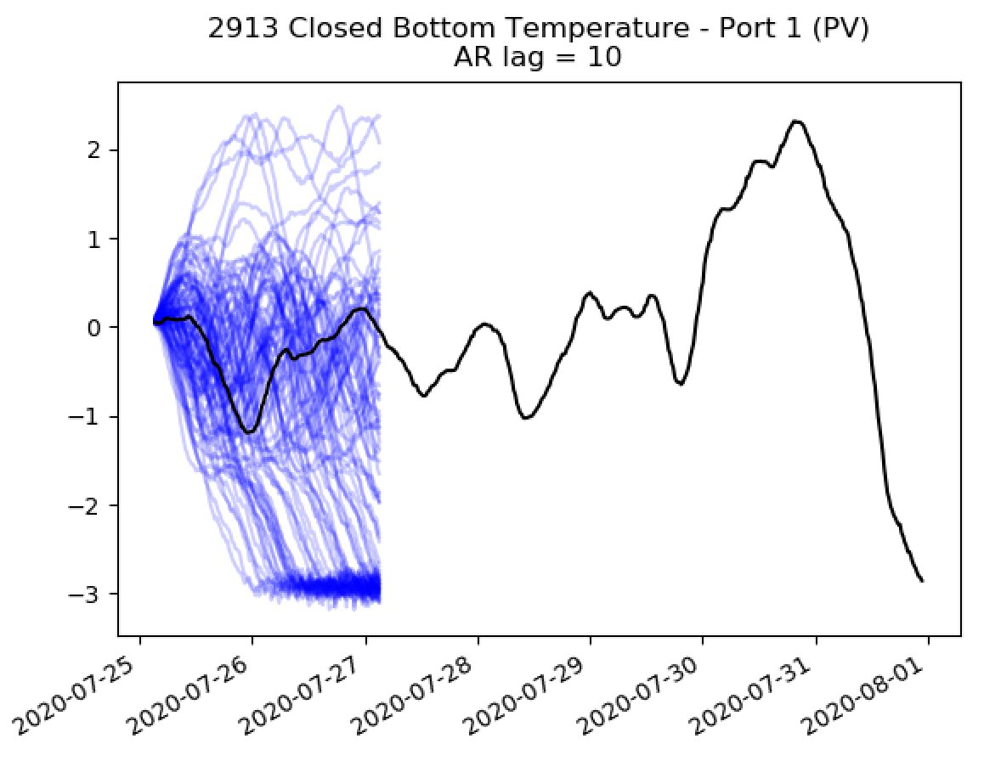
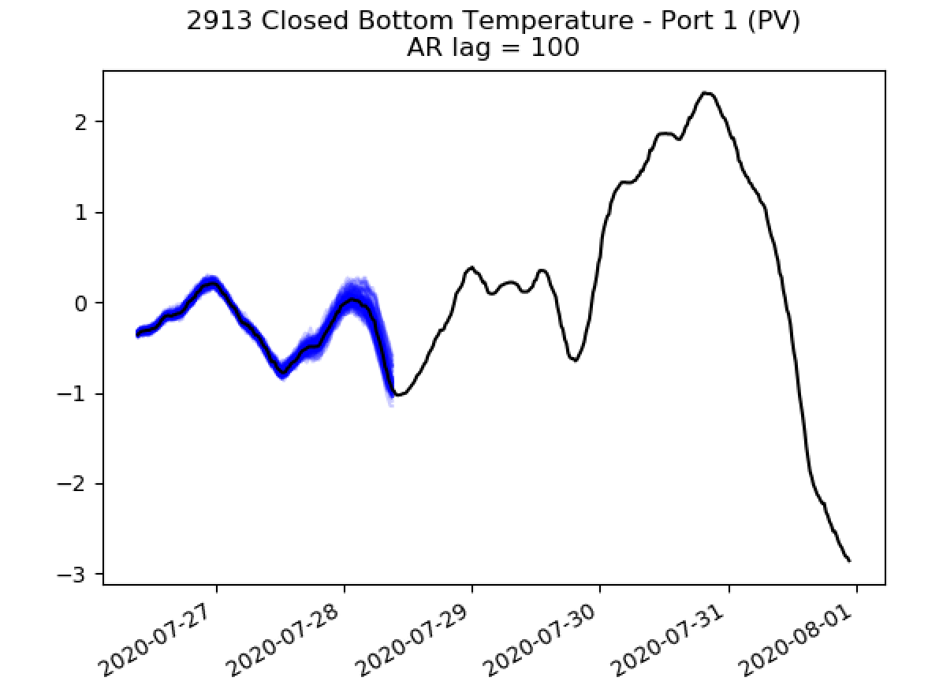
Predictions with Uncertain Tag Data
Here the time lag is equal to 24 hours, so we have to predict this input 52 hours into the future.
If we adopt this approach, then we will need a separate AR model for each input that has been identified as important. We then need to propagate the uncertainty in the input into our GP model…

Slide 22
Predictions with Uncertain Tag Data
What’s the best way to implement this – note that the uncertain inputs will have to be propagated through the Gaussian Process.
Sticking with this sampling based approach could be very slow.

Slide 23
Predictions with Uncertain Tag Data
What’s the best way to implement this – note that the uncertain inputs will have to be propagated through the Gaussian Process.
Sticking with this sampling based approach could be very slow.
This distribution is non-Gaussian, but we can approximate it as being Gaussian [Girard, 2004].
A Gaussian input to the GP model – there are closed-form solutions for this (Pete has these somewhere…)
Girard, A. (2004). Approximate methods for propagation of uncertainty with Gaussian process models (Doctoral dissertation, University of Glasgow).

Slide 24
Predictions with Uncertain Tag Data
Steps needed to implement this:
Separate AR model for each uncertain input (only focusing on those identified as important).
CHECK THAT THESE MODELS ARE SENSIBLE OUTSIDE OF TRAINING DATA.
Approximate input uncertainty as Gaussian.
CHECK APPROXIMATIONS ARE CLOSE TO MONTE-CARLO RUNS.
Propagate input uncertainty through the GP (complicated but low-risk).
Disclaimer:
This will be difficult!
The resulting uncertainty bounds at 72 hours may be very large – will have to wait and see.

Slide 25
















Predictions with Uncertain Tag Data
Sketching the final dashboard that we would be aiming for:

Slide 26
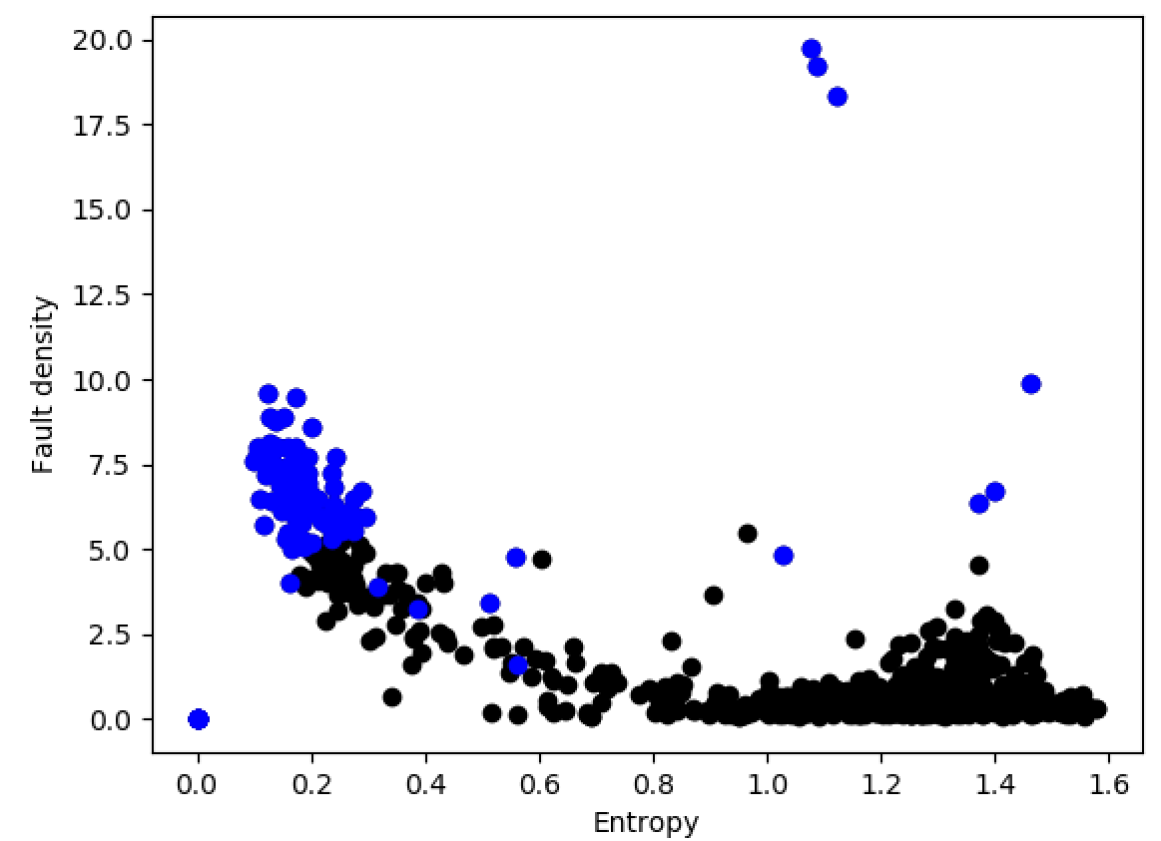
ISRA 5D
Choosing points where total fault density > 5 and entropy < 0.6.

Slide 27
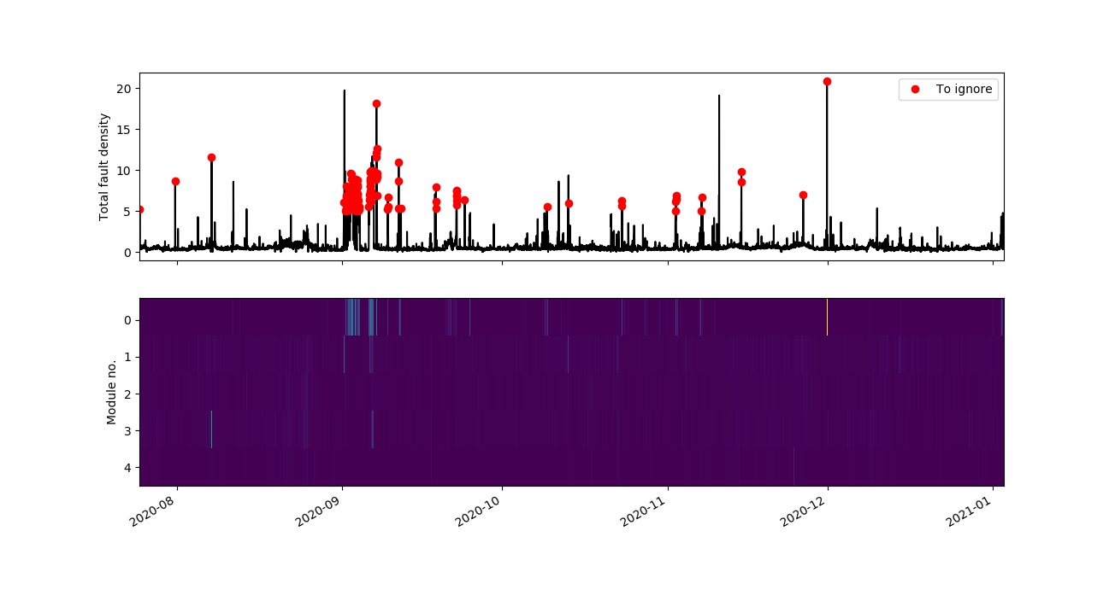
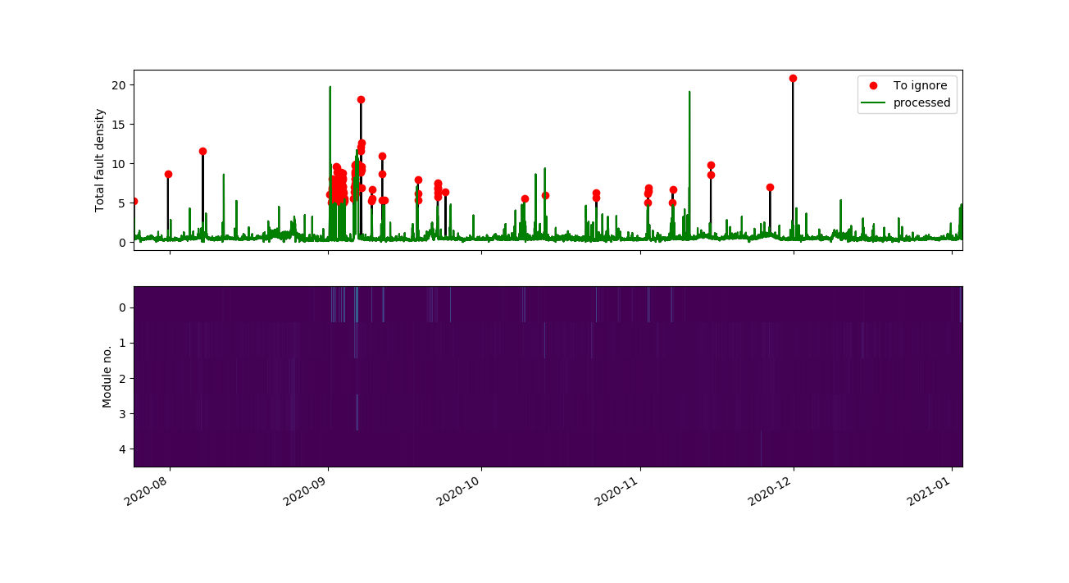
ISRA 5D
After identifying ‘to ignore’ points replace readings from the offending module with the average across the remaining modules

Slide 28
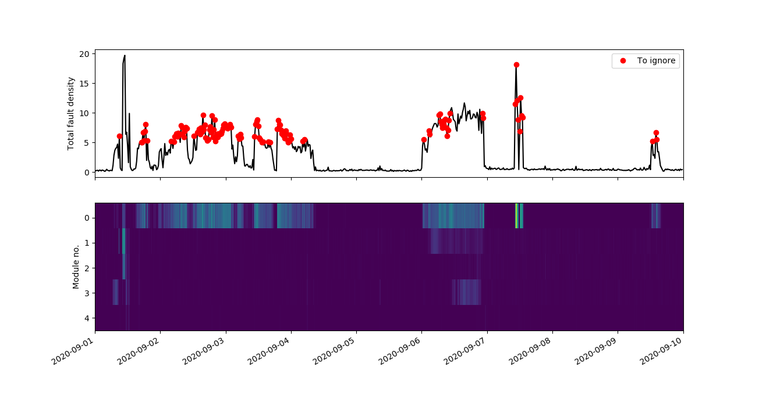
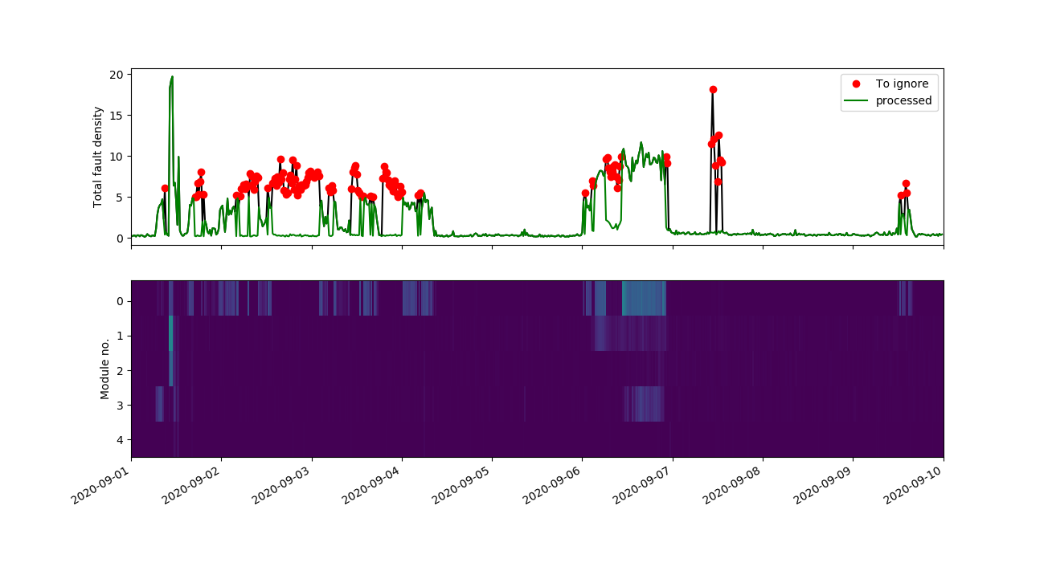
ISRA 5D
Some points are not recognised due to high entropy

Slide 29
ISRA 5D
Choosing points where total fault density > 5

Slide 30
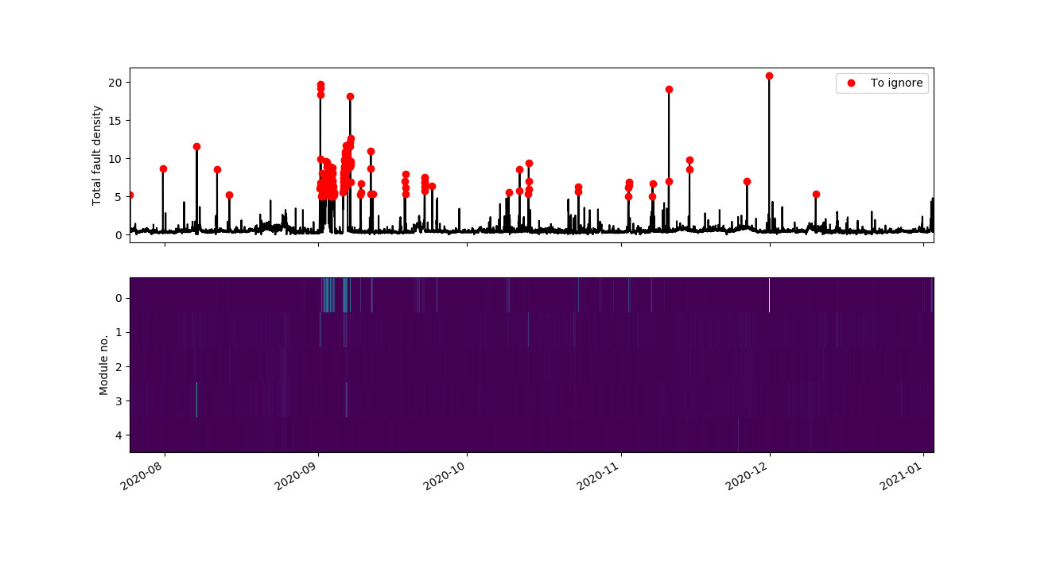
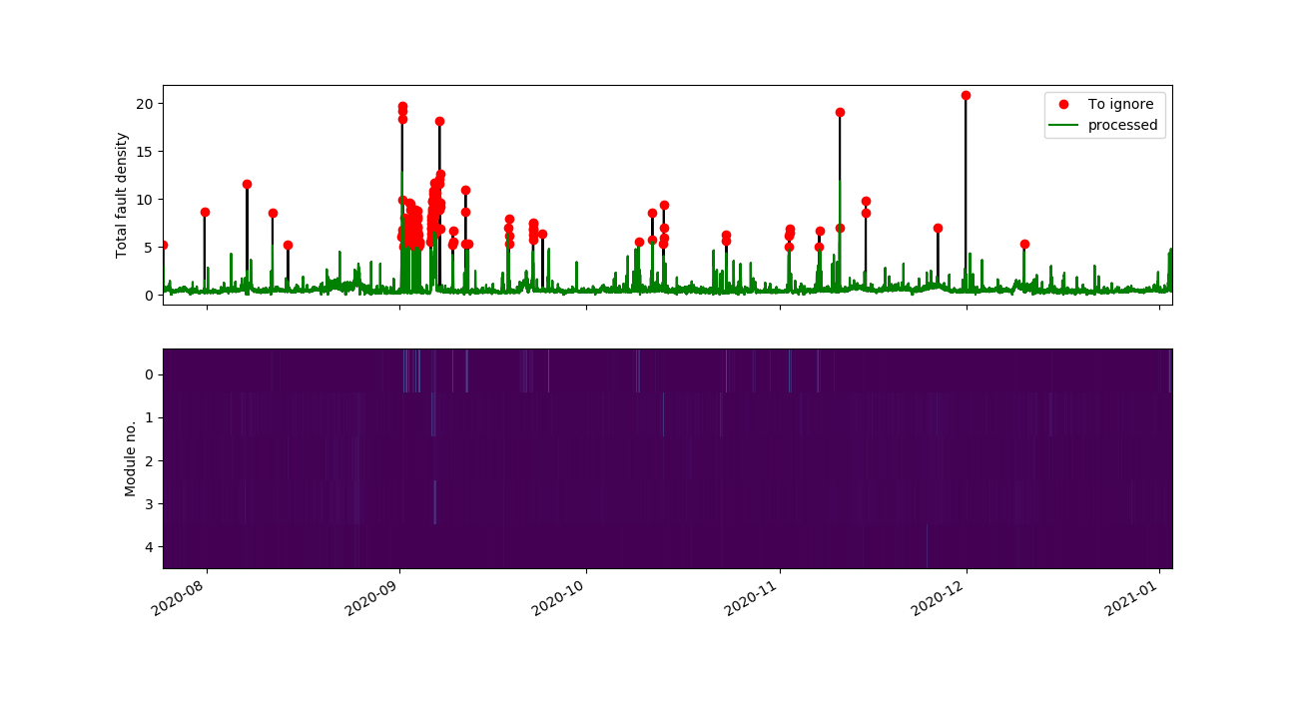
ISRA 5D
Again readings from the offending module are replaced with the average across the remaining modules

Slide 31

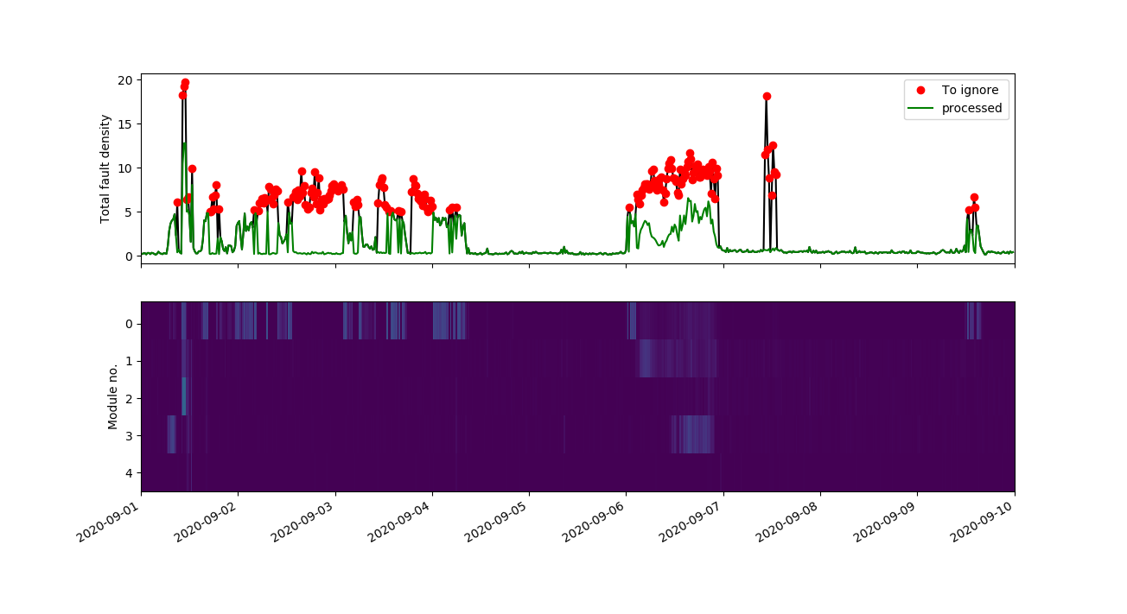
ISRA 5D
These readings are also replaced with average of remaining modules

Slide 32
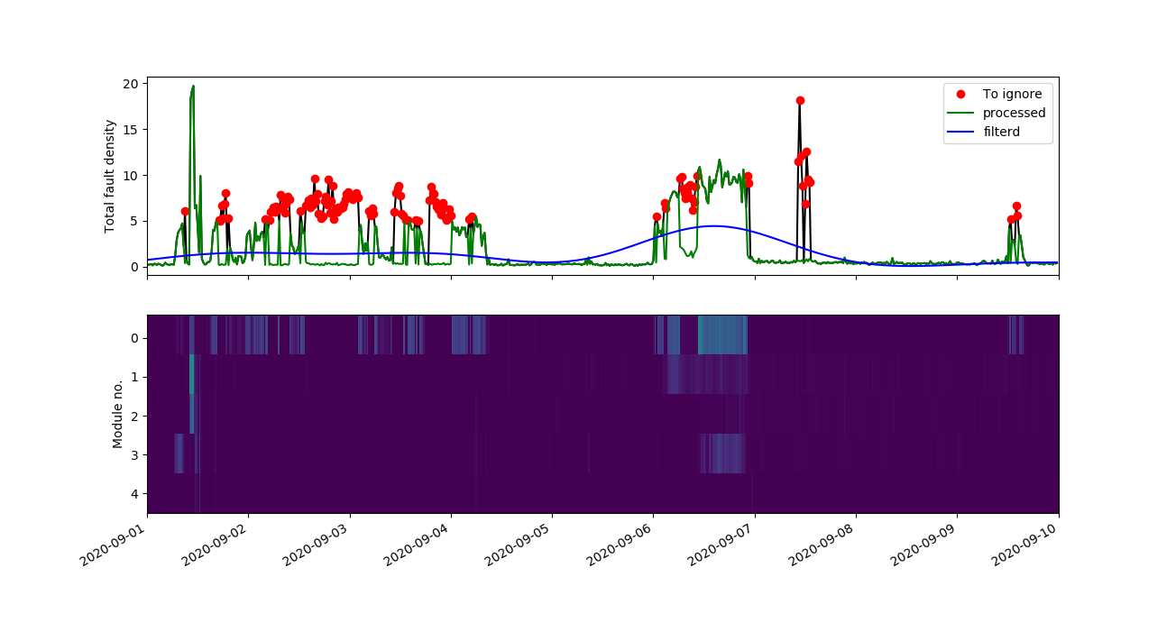

ISRA 5D
Comparing filtered signals obtained from different classifying conditions

Slide 33

ISRA 5D
Choosing points where total fault density > 5 and entropy < 0.6.

Slide 34
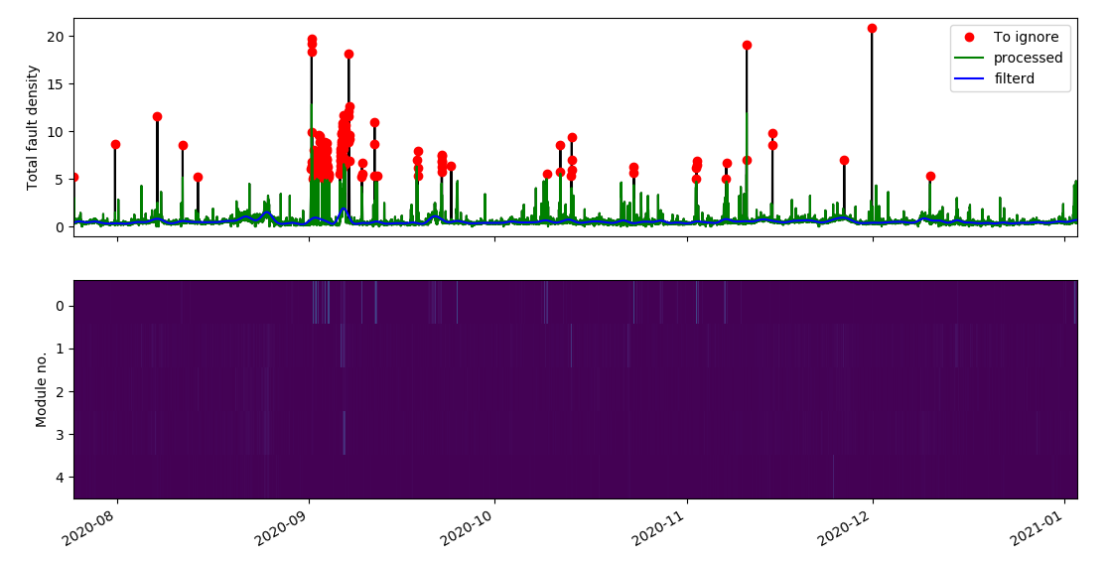
ISRA 5D
Choosing points where total fault density > 5

Slide 35
ISRA 5D
We find that the decision rule:
Include if total fault density < 5 and entropy > 0.6.
Results in conservative labelling of the low fault density values.
We can then decide if we process these values or not.

Slide 36
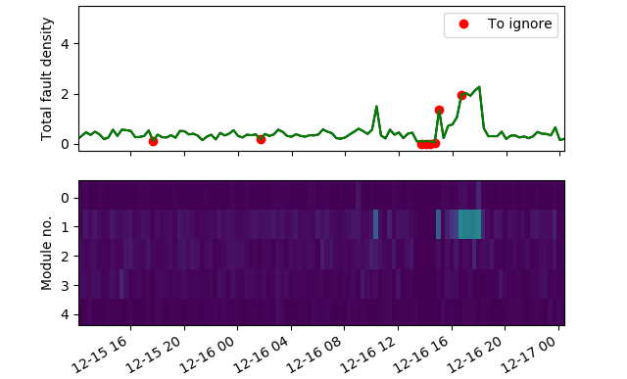
ISRA 5D

Slide 37
ISRA 5D

Slide 38
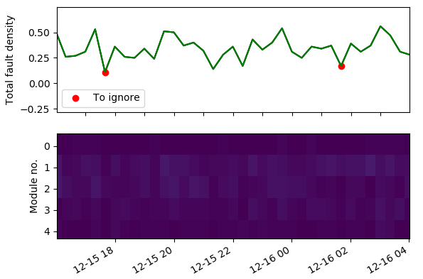
ISRA 5D
Total fault density = 0.11
Total fault density = 0.17

Slide 39
ISRA 5D
Total fault density = 0.11
Total fault density = 0.17
What should be a realistic threshold value to process the low fault density data?
Right now Threshold < 0.01
Then use the previous fault density value

Slide 40
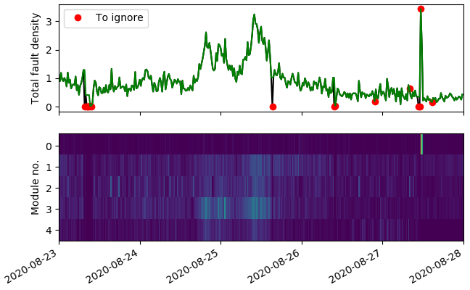
ISRA 5D
Threshold < 0.01
Then use the previous fault density value

Slide 41
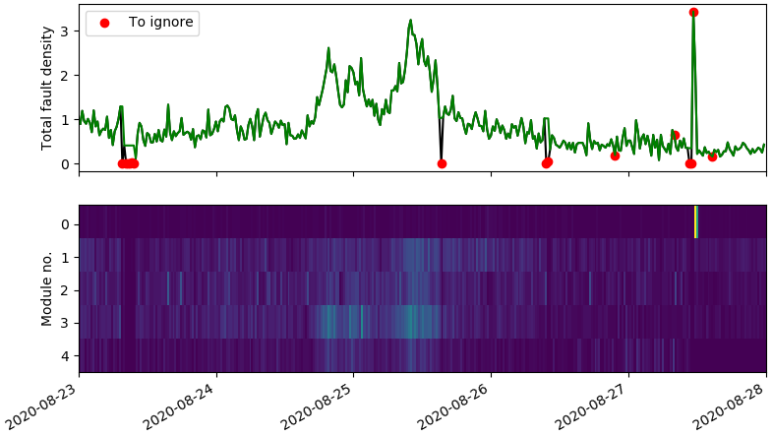
ISRA 5D
Threshold < 0.1
Then use the previous fault density value

Slide 42
Thank you for your attention. ANY QUESTIONS?

